Slide 1
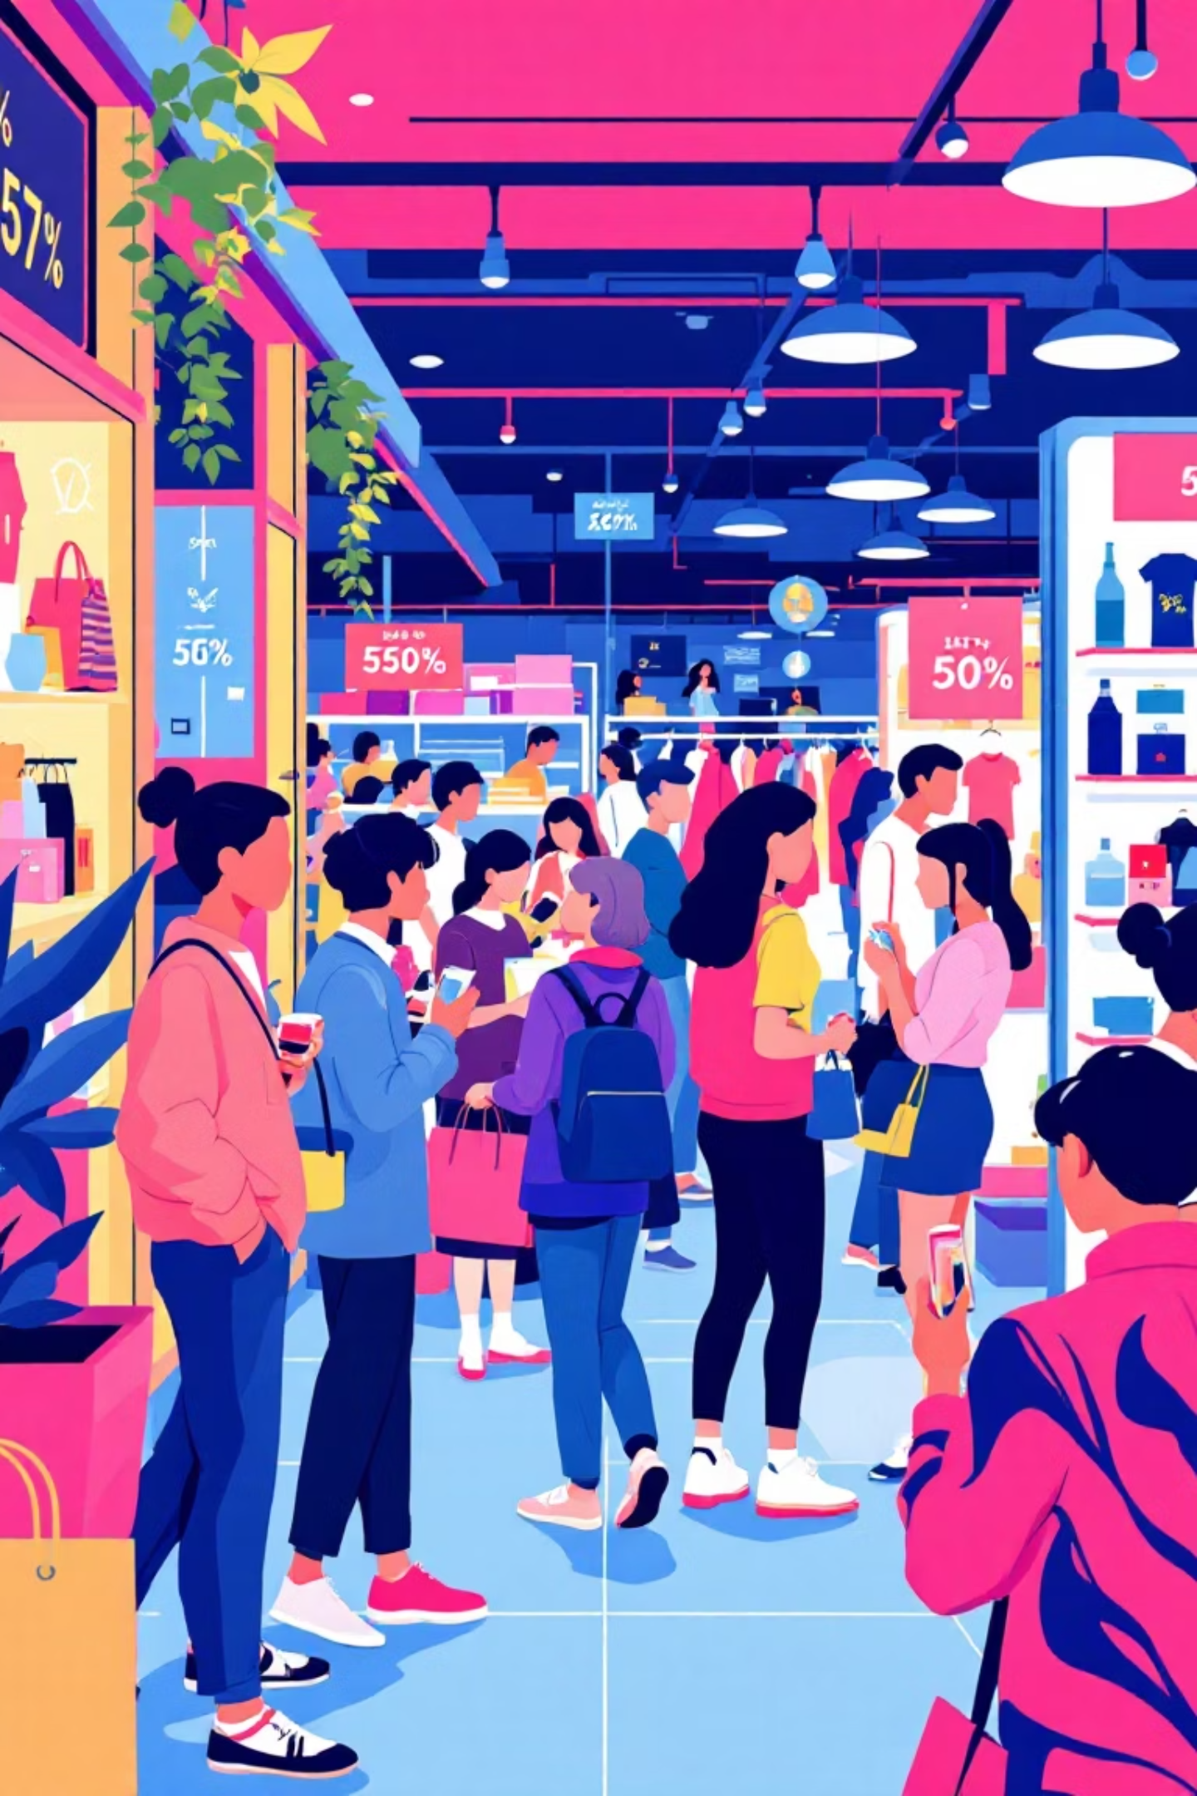
Customer Shopping Behavior Analysis
Uncovering insights from transactional data to guide strategic business decisions.

Slide 2
Project Overview
Data Source
Primary Goal
Strategic Impact
3,900 purchases across various product categories.
Uncover spending patterns, customer segments, product preferences, and subscription behavior.
Guide business decisions for optimization and growth.

Slide 3

Dataset Summary: Key Features
Customer Demographics
Age, Gender, Location, Subscription Status.
Purchase Details
Item, Category, Amount, Season, Size, Color.
Shopping Behavior
Discount, Promo Code, Previous Purchases, Frequency, Review, Shipping.

Slide 4
Exploratory Data Analysis: Python
01
02
03
Data Loading & Exploration
Missing Data Handling
Column Standardization
Imported with pandas, checked structure and summary statistics.
Imputed 'Review Rating' using median per category.
Renamed to snake_case for readability.
04
05
Feature Engineering
Database Integration
Created age_group and purchase_frequency_days.
Loaded cleaned data into PostgreSQL for SQL analysis.

Slide 5

SQL Analysis: Key Business Insights
Revenue by Gender
High-Spending Discount Users
Male: $157,890, Female: $75,191
839 customers spent above average with discounts.
Top 5 Products by Rating
Gloves (3.86), Sandals (3.84), Boots (3.82), Hat (3.80), Skirt (3.78).

Slide 6

SQL Analysis: Deeper Dive
Shipping Type Comparison
Subscribers vs. Non-Subscribers
Express: $60.48 avg, Standard: $58.46 avg.
Subscribers: $59.49 avg spend, Non-Subscribers: $59.87 avg spend.
Customer Segmentation
Loyal (3116), Returning (701), New (83).

Slide 7
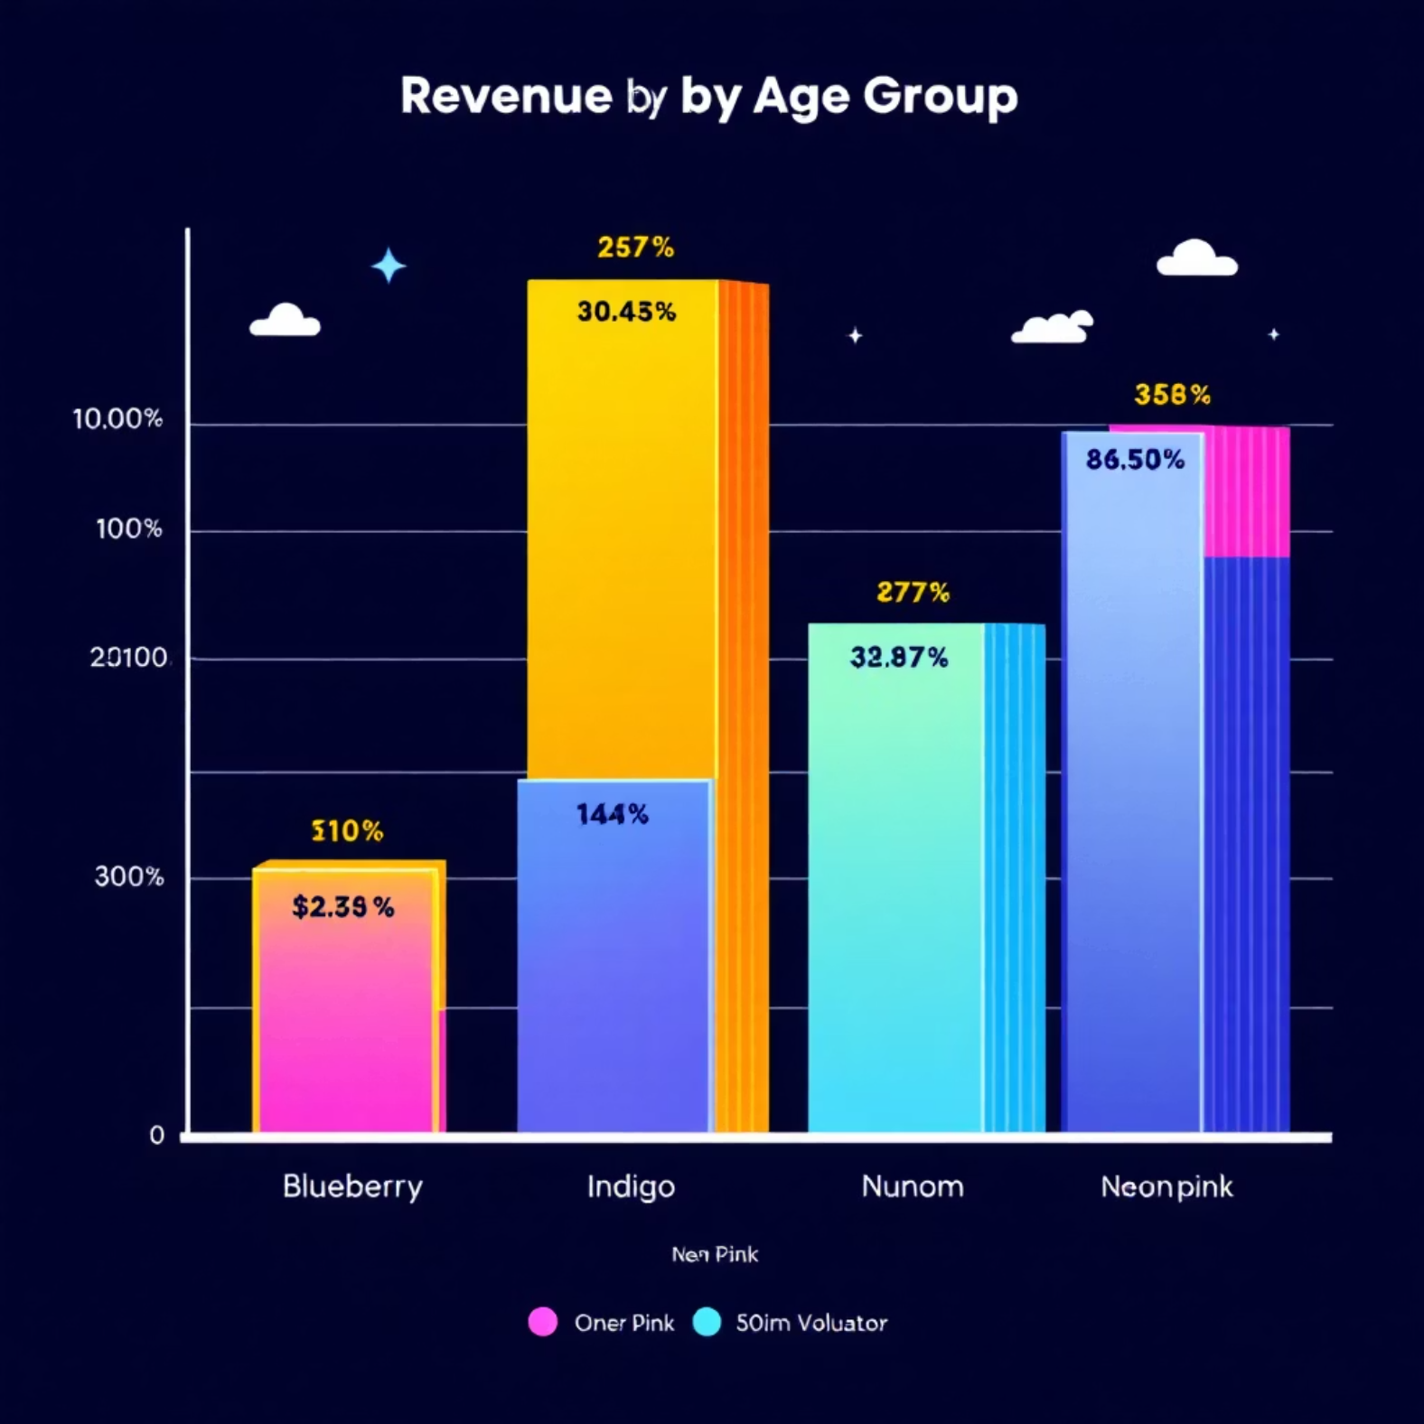
SQL Analysis: Product & Age Insights
Discount-Dependent Products
Repeat Buyers & Subscriptions
Hat (50%), Sneakers (49.66%), Coat (49.07%), Sweater (48.17%), Pants (47.37%).
958 repeat buyers are subscribers, 2518 are not.
Revenue by Age Group
Young Adult: $62,143, Middle-aged: $59,197, Adult: $55,978, Senior: $55,763.

Slide 8
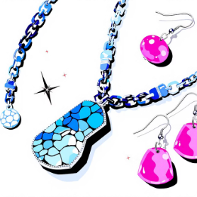
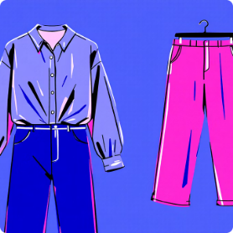

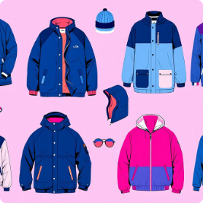
Top Products by Category
Accessories
Clothing
Footwear
Outerwear
Jewelry (171), Sunglasses (161), Belt (161).
Blouse (171), Pants (171), Shirt (169).
Sandals (160), Shoes (150), Sneakers (145).
Jacket (163), Coat (161).

Slide 9
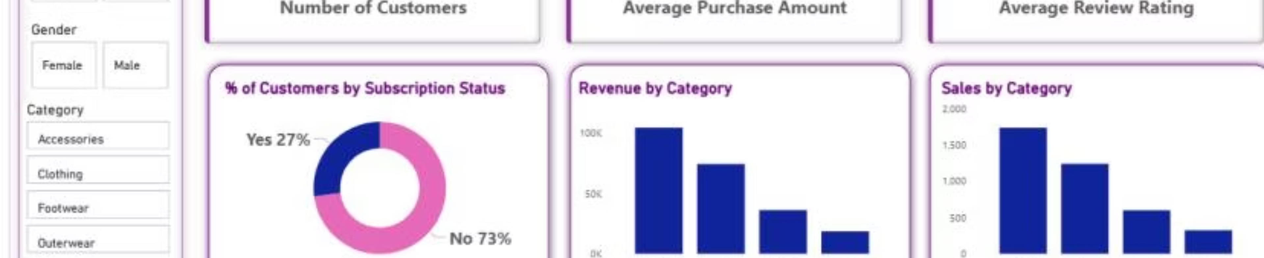
Interactive Dashboard in Power BI
Visualizing insights for dynamic decision-making.
3.9K
$59.76
3.75
Customers
Avg. Purchase
Avg. Review

Slide 10

Business Recommendations
Boost Subscriptions
Promote exclusive benefits for subscribers.
Customer Loyalty Programs
Reward repeat buyers to foster loyalty.
Review Discount Policy
Balance sales boosts with margin control.
Product Positioning
Highlight top-rated and best-selling products.
Targeted Marketing
Focus on high-revenue age groups and express-shipping users.

